Slide 1
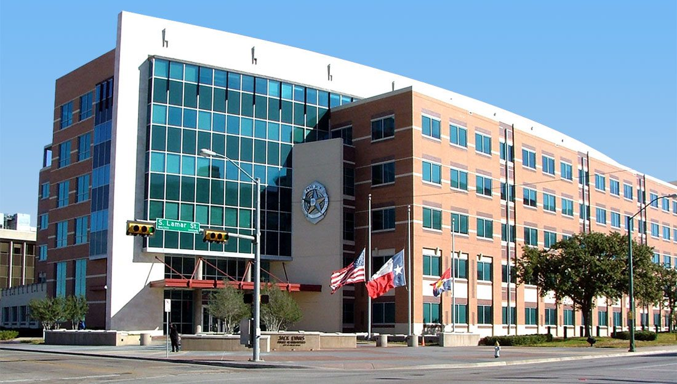

Dallas Police Arrests SMU Data Science
Calvin Cusick, Malachai Cravens, Samuel Slomowitz

Slide 2
Disclaimer
We are not criminologists, sociologists, or law-enforcement professionals. We are simply analyzing a public dataset on arrests, which included demographic variables. We are NOT in any way claiming that certain ethnic or racial group are more prone to commit certain crimes, get arrested, or be more dangerous to others. Rather, we are creating a data visualization dashboard for more qualified experts to draw their own conclusions. Our analysis and call-to-action is simply our take on the data and does not reflect any compelling statements, which some people may or may not take offense or take out of context. Please do NOT use our data to make any uninformed or misguided decisions about others.

Slide 3




Data Story
Larry is looking for internship
Officer James is looking for an intern
Larry offers to analyze arrest data as it relates to racial categories and the Dallas Police Department.
Officer James gives Larry the Data Analytics Internship

Slide 4
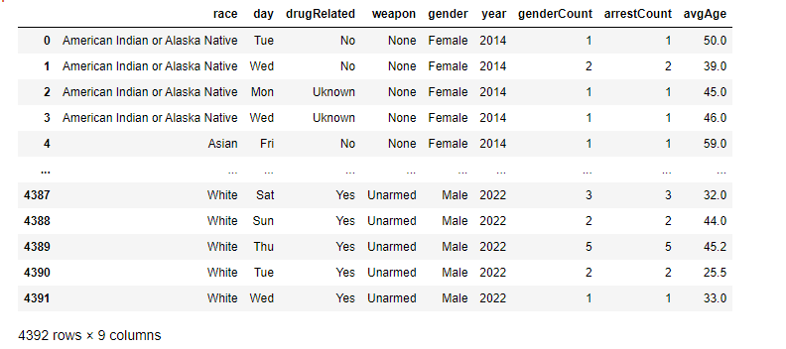
Plot.ly Dataset

Slide 5
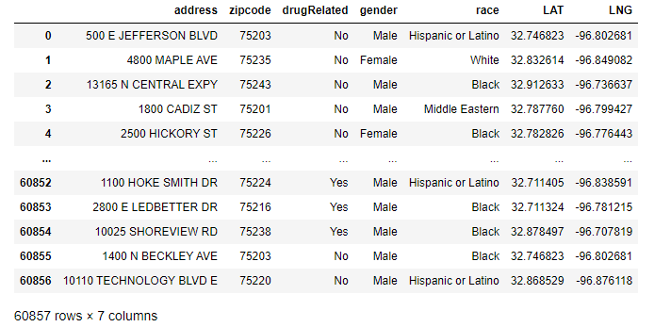
Leaflet Map Dataset

Slide 6
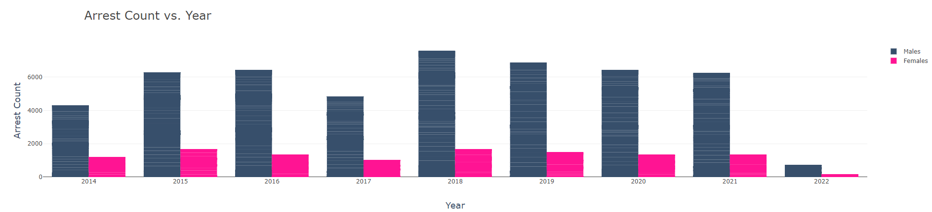
How do race and gender related to number of arrests?
When considering all race categories, Males were arrested more frequently between 2014 and 2022 in Dallas, TX.

Slide 7
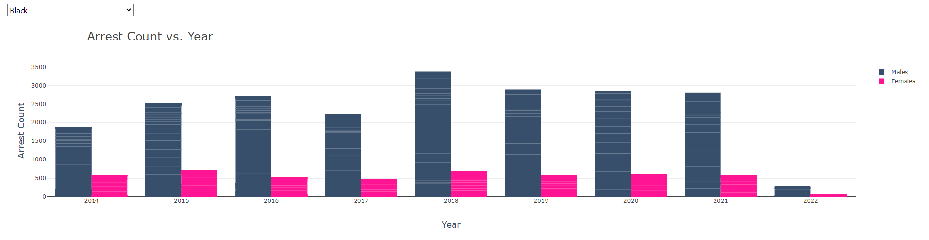
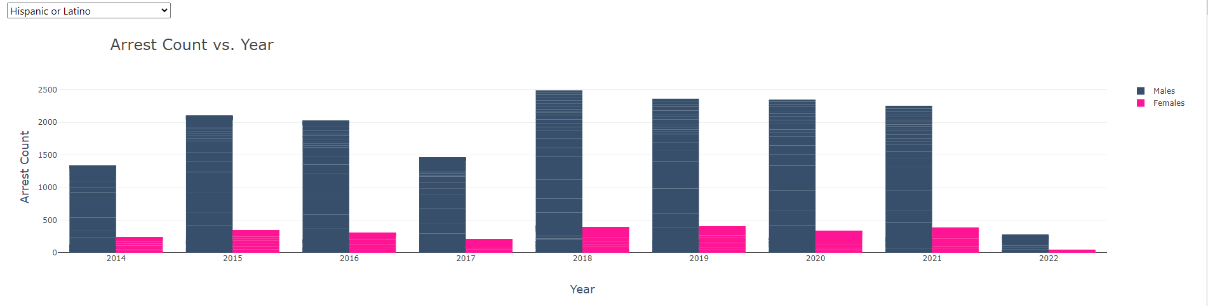
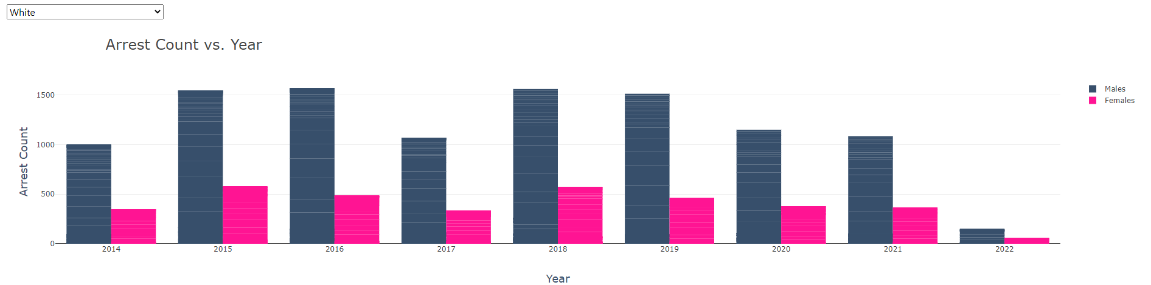

Slide 8
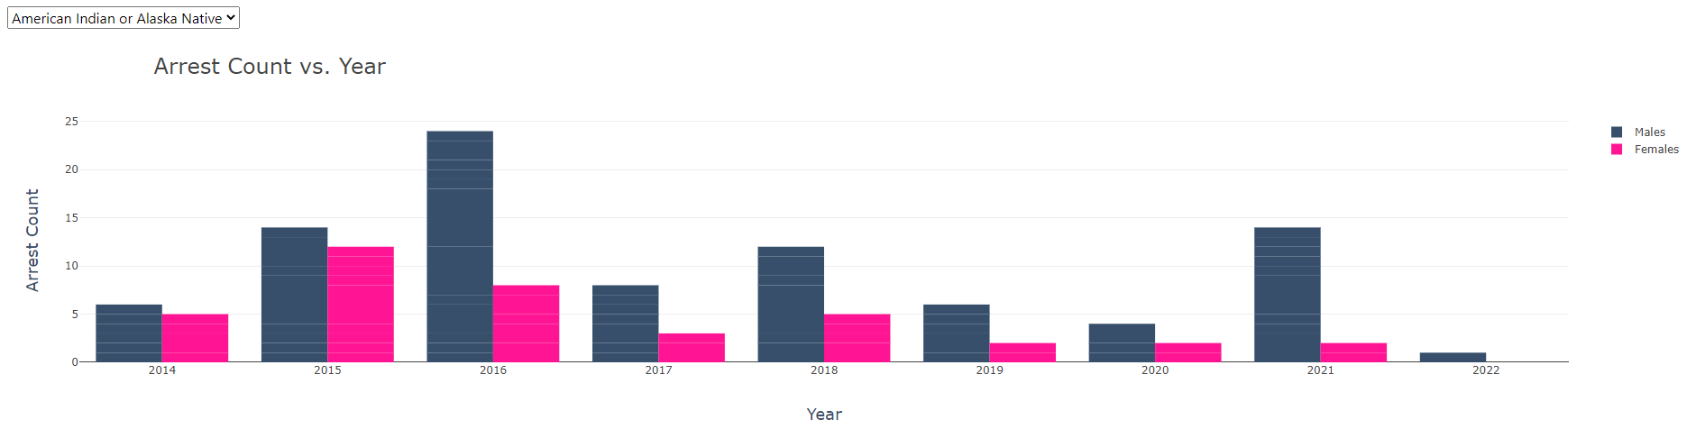
White, Black, and Latino had the most Arrests Counts where as…

Slide 9
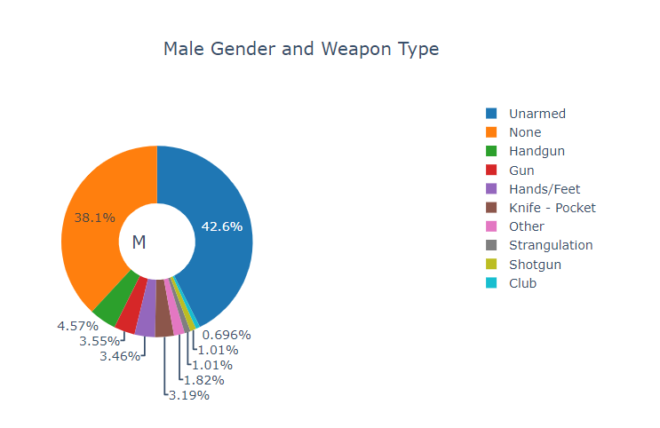
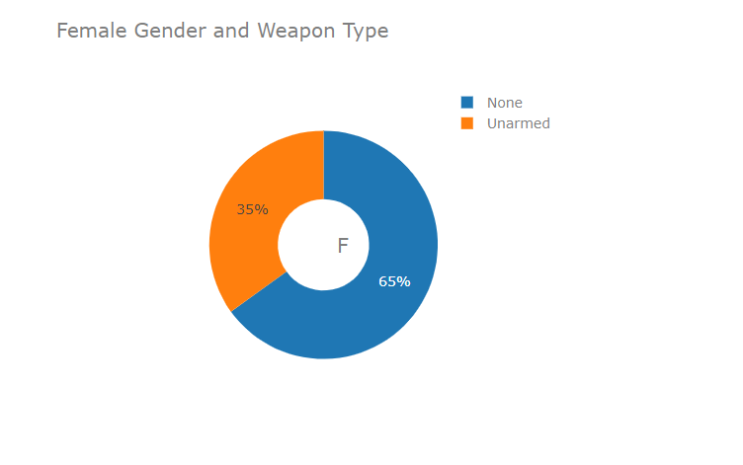
Middle Eastern Race and Weapon Type Divided by Gender

Slide 10
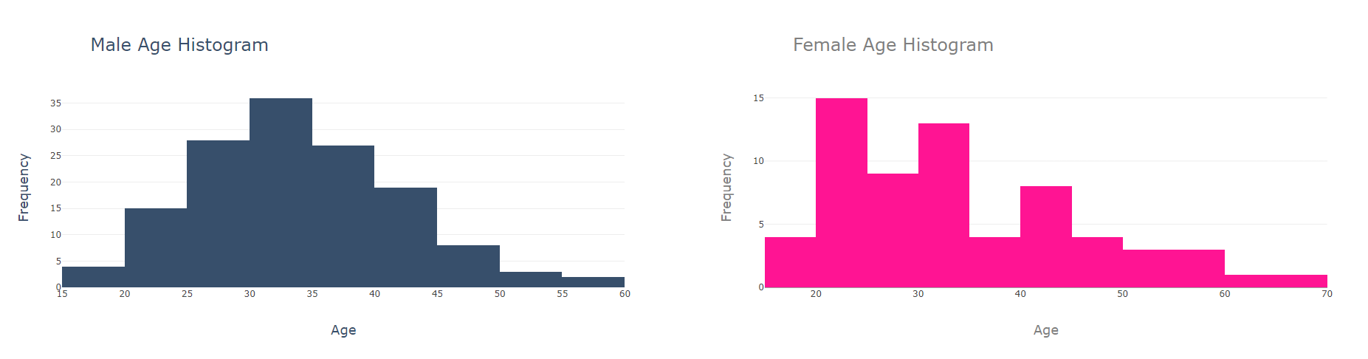
Asian Race and Age Frequency Divided by Gender

Slide 11
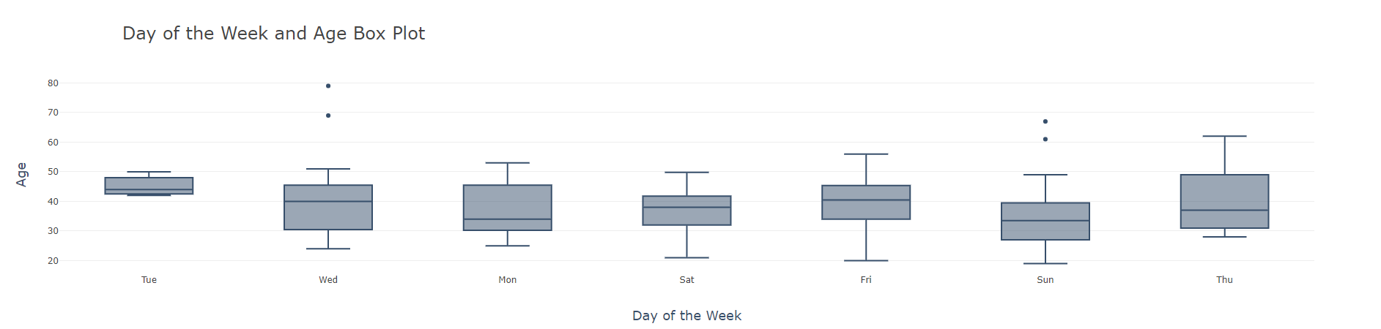
American Indian Arrestees and Days of the Week/Age

Slide 12
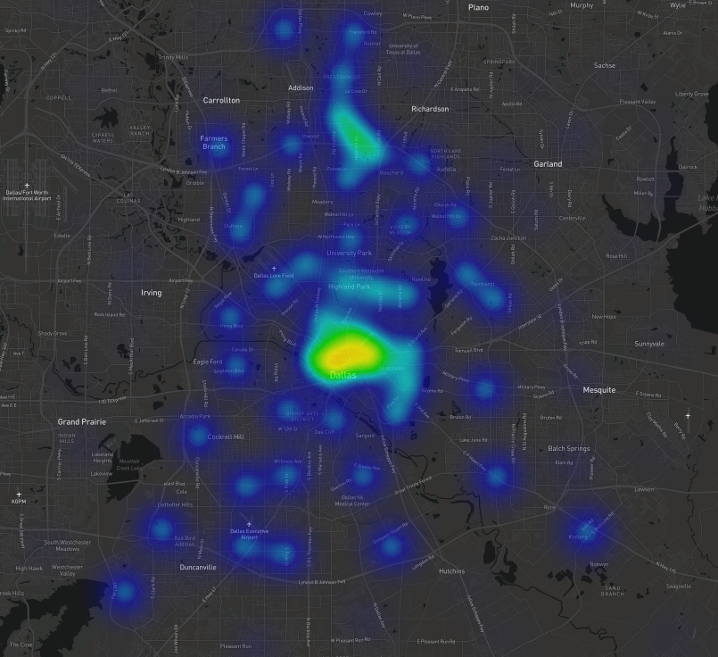
It Heats-up in Downtown Dallas

